Slide 1
Provisio Project
Team Delta

Slide 2
Team Intro – Harlie Hall
I am currently located in St. Louis, MO
I am currently finishing up my Bachelor's degree to further my education in Software Development
I enjoy going to Cardinal's baseball games, going hiking, and spending time with my friends.
During the Provisio Project, I acted as the team leader and completed the following tasks:
Updated the KanBan Board
Developed the Reservation, Reservation Summary, and Reservation Lookup Pages
Updated Code and Design throughout the project
Created Test Cases for the different web pages

Slide 3
Team Intro – Anamanno Umanah
I am based in Fargo ND
I currently work as a bank manager and virtual tutor.
I enjoy playing video games, basketball or Ping-Pong when I am not working.
On our Provisio project, I helped design/code the landing, about us and contact us pages.

Slide 4
Team Intro – Gregory Wnek
I am based in Cincinnati, OH
I currently work as a manager at Chipotle.
I enjoy target practice, reading, and working out.
On our Provisio project, I helped design/code the locations and registration pages and put together the video demonstration.

Slide 5
Team Intro

Slide 6
The Goal of the Provisio Project
Who is Provisio?
Provisio is a company that offers many hotel locations across the United States
What Provisio Needs?
Provisio wants to provide customers with a way to:
book a stay,
look up a previous reservation,
view any loyalty points that have been gained,
and view more information about the hotel
How Can We Satisify This Need?
Our Team has created a web application that will allow Provisio Customers to:
book a stay,
look up a reservation or loyalty points,
register as a user,
and view Provisio Information

Slide 7
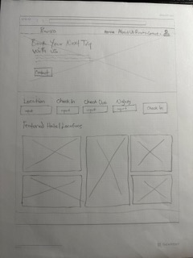
Prototypes – Landing Page
Home/Opening Page for the user that is navigating to the Provisio Website
Provides basic information to the User about Provisio Hotels

Slide 8
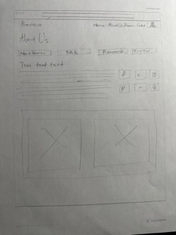
Prototypes – About Us Page
Provides further information about the Provisio Hotels

Slide 9
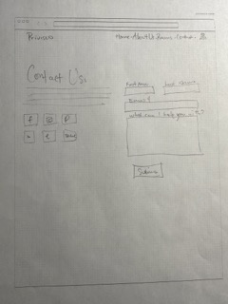
Prototypes – Contact Us Page
Provides users with a contact form to contact the Provisio Company
Users can access even more contact information for Provisio, such as:
Twitter
Facebook
Instagram

Slide 10
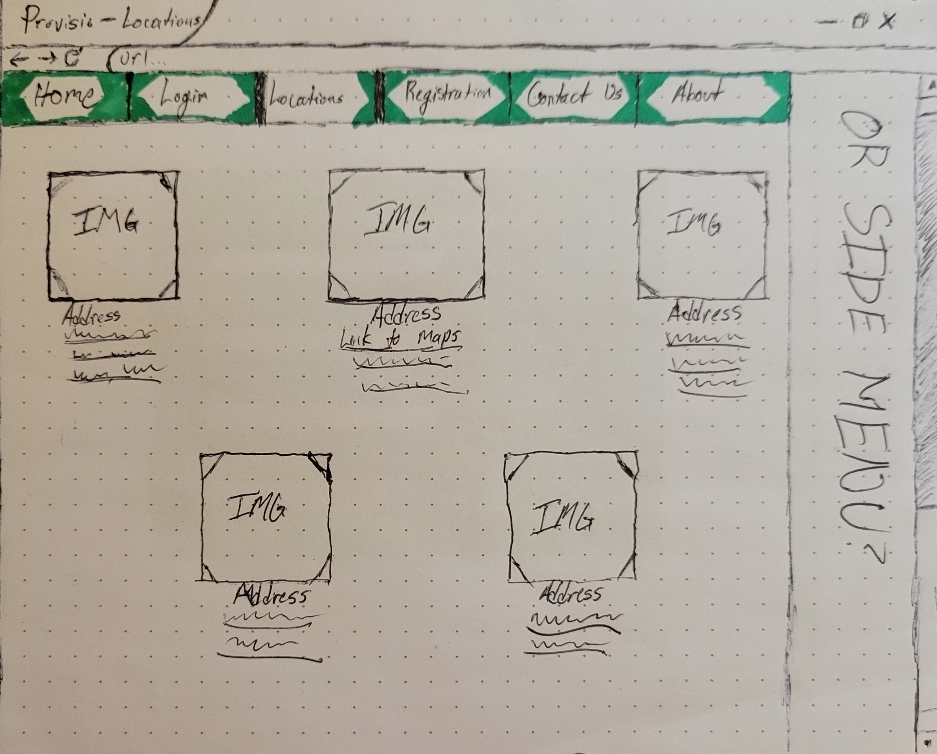
Prototypes – Locations Page
Provides users with further location information about the Provisio Hotel Locations

Slide 11
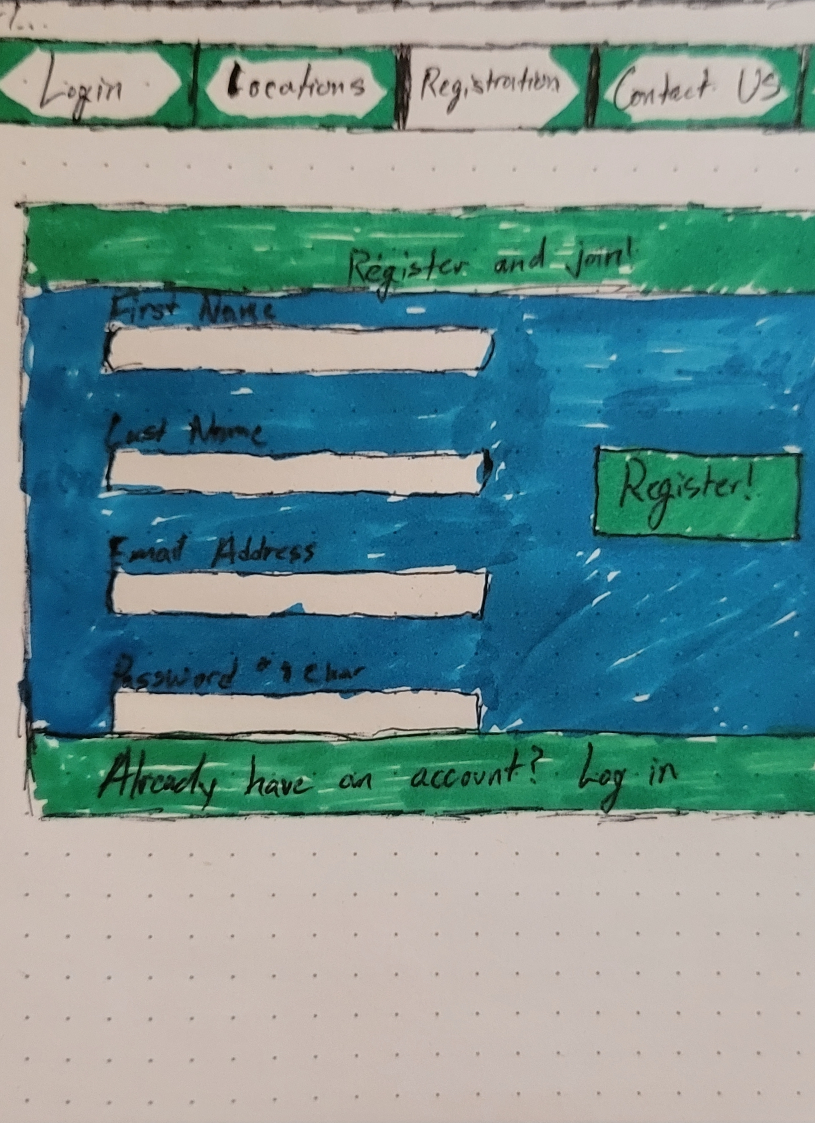
Prototypes – Registration Page
Allows users the ability to register for a Provisio Account, that will be used for booking reservations and viewing loyalty points
Allows users a link to the Login page if they already have an account

Slide 12
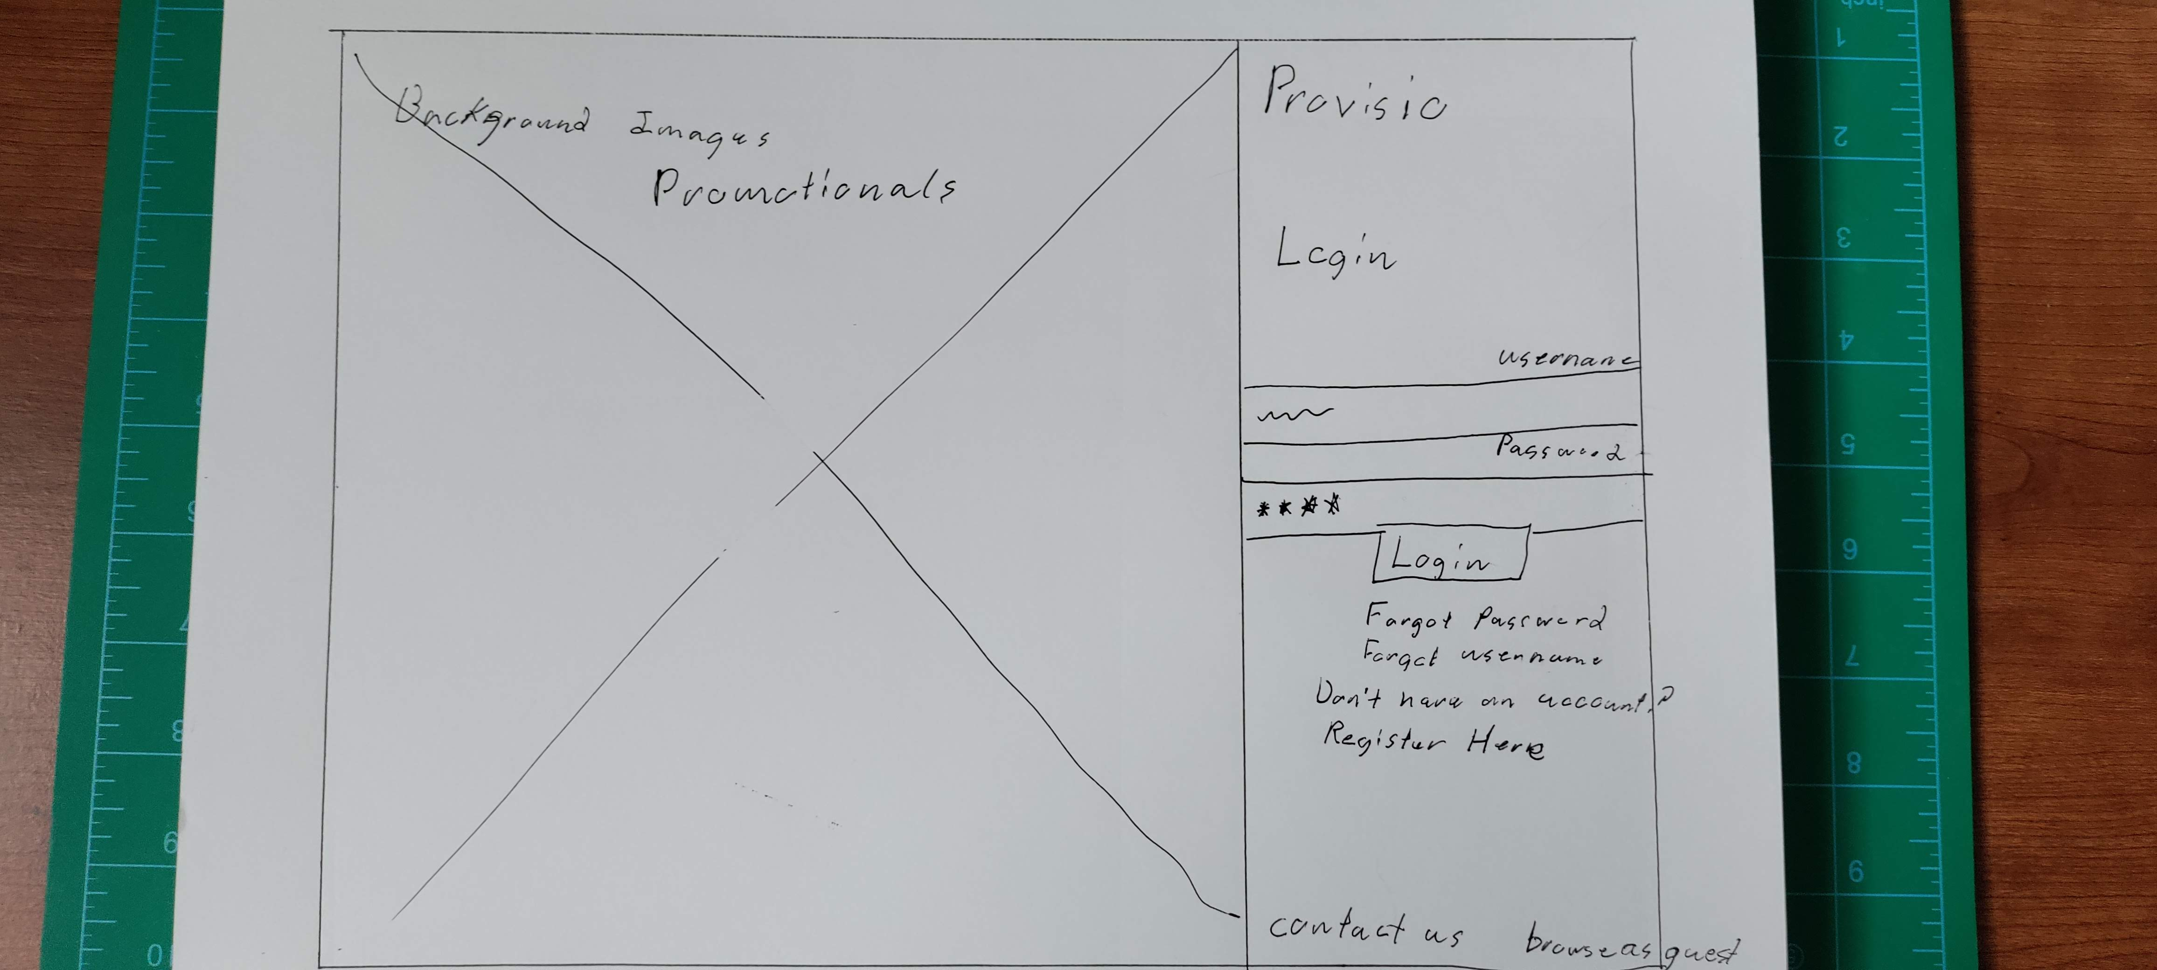
Prototypes – Login Page
Provides users a way to login to their Provisio Account
Also provides users with options to:
browse as a guest,
register for an account,
Or reset password/username

Slide 13
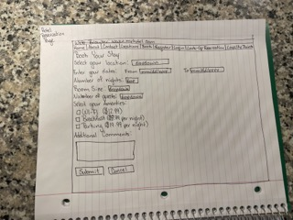
Prototypes – Hotel Reservation Page
Provides users with a simple page to be able to book a reservation
The user will be able to select room size, dates, locations, etc.
Once the user selects Submit, they will be prompted to login or create an account

Slide 14
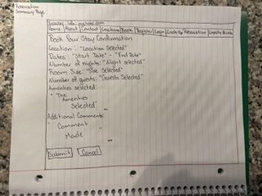
Prototypes – Reservation Summary Page
Once the user completes the form in the Hotel Reservation Page and successfully enters a valid login, they will see a read only view of the information from the previous form, they can then select Submit to view the Reservation ID or Cancel to navigate back to the Hotel Reservation Page

Slide 15
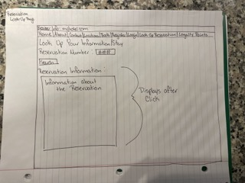
Prototypes – Reservation Lookup Page
The user will be able to input a valid Reservation ID (such as one provided in the Reservation Summary Page) and view information about the Reservation

Slide 16
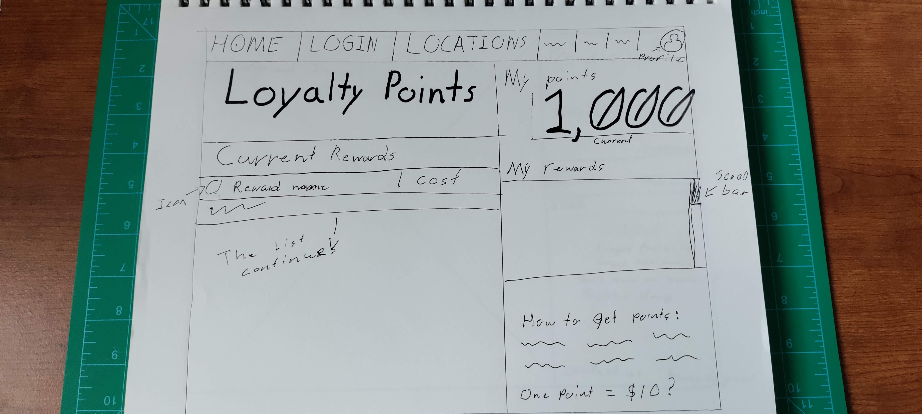
Prototypes – Loyalty Points Tracking Page
The user will be able to view loyalty points that have been gained from booking stays with a Provisio Hotels
The user will be able to view this based on the User information that they have created in the Registration Page

Slide 17
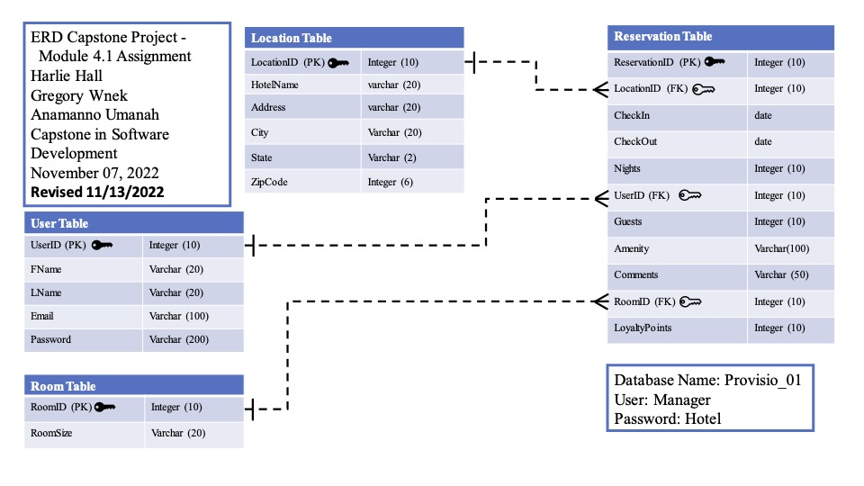
Entity Relationship Diagram

Slide 18
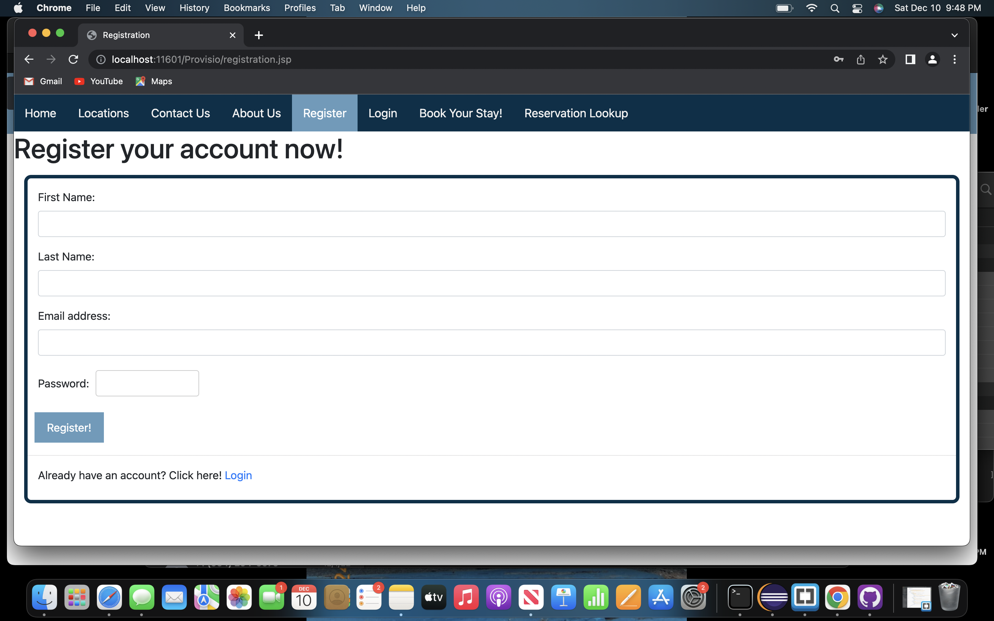
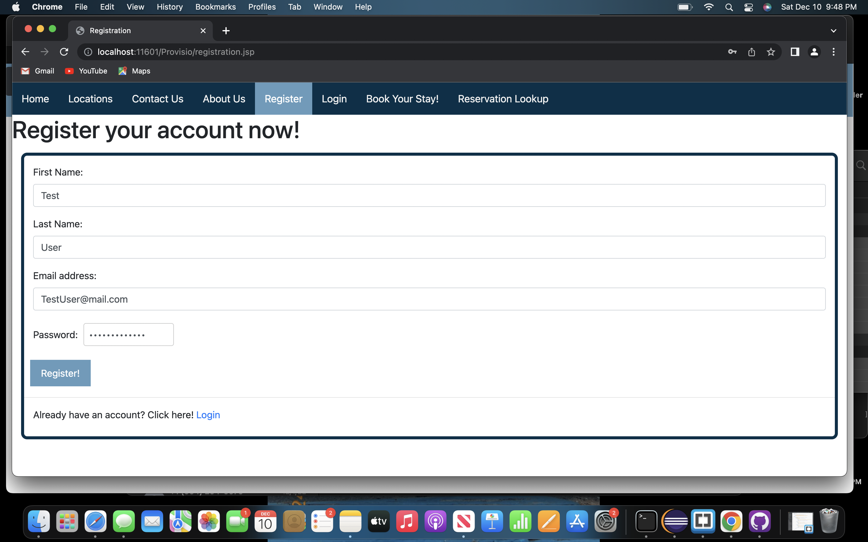
Tests – Registration Page
Tested the user's ability to Register a New User in the Registration Page
The test consisted of the following steps:
Navigate to the Registration Page
Fill out the Registration Form
Select the Submit button
The user was able to successfully complete the Registration Form

Slide 19
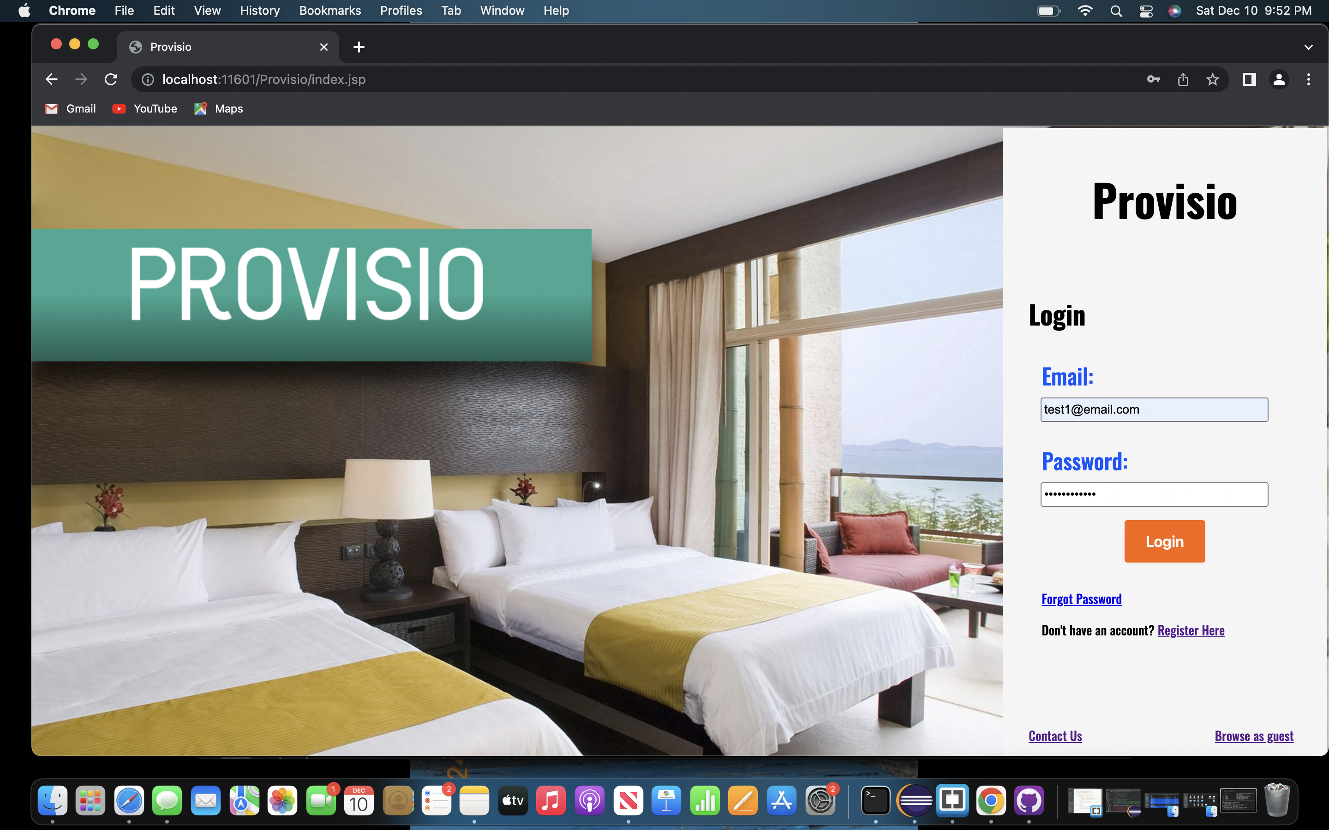
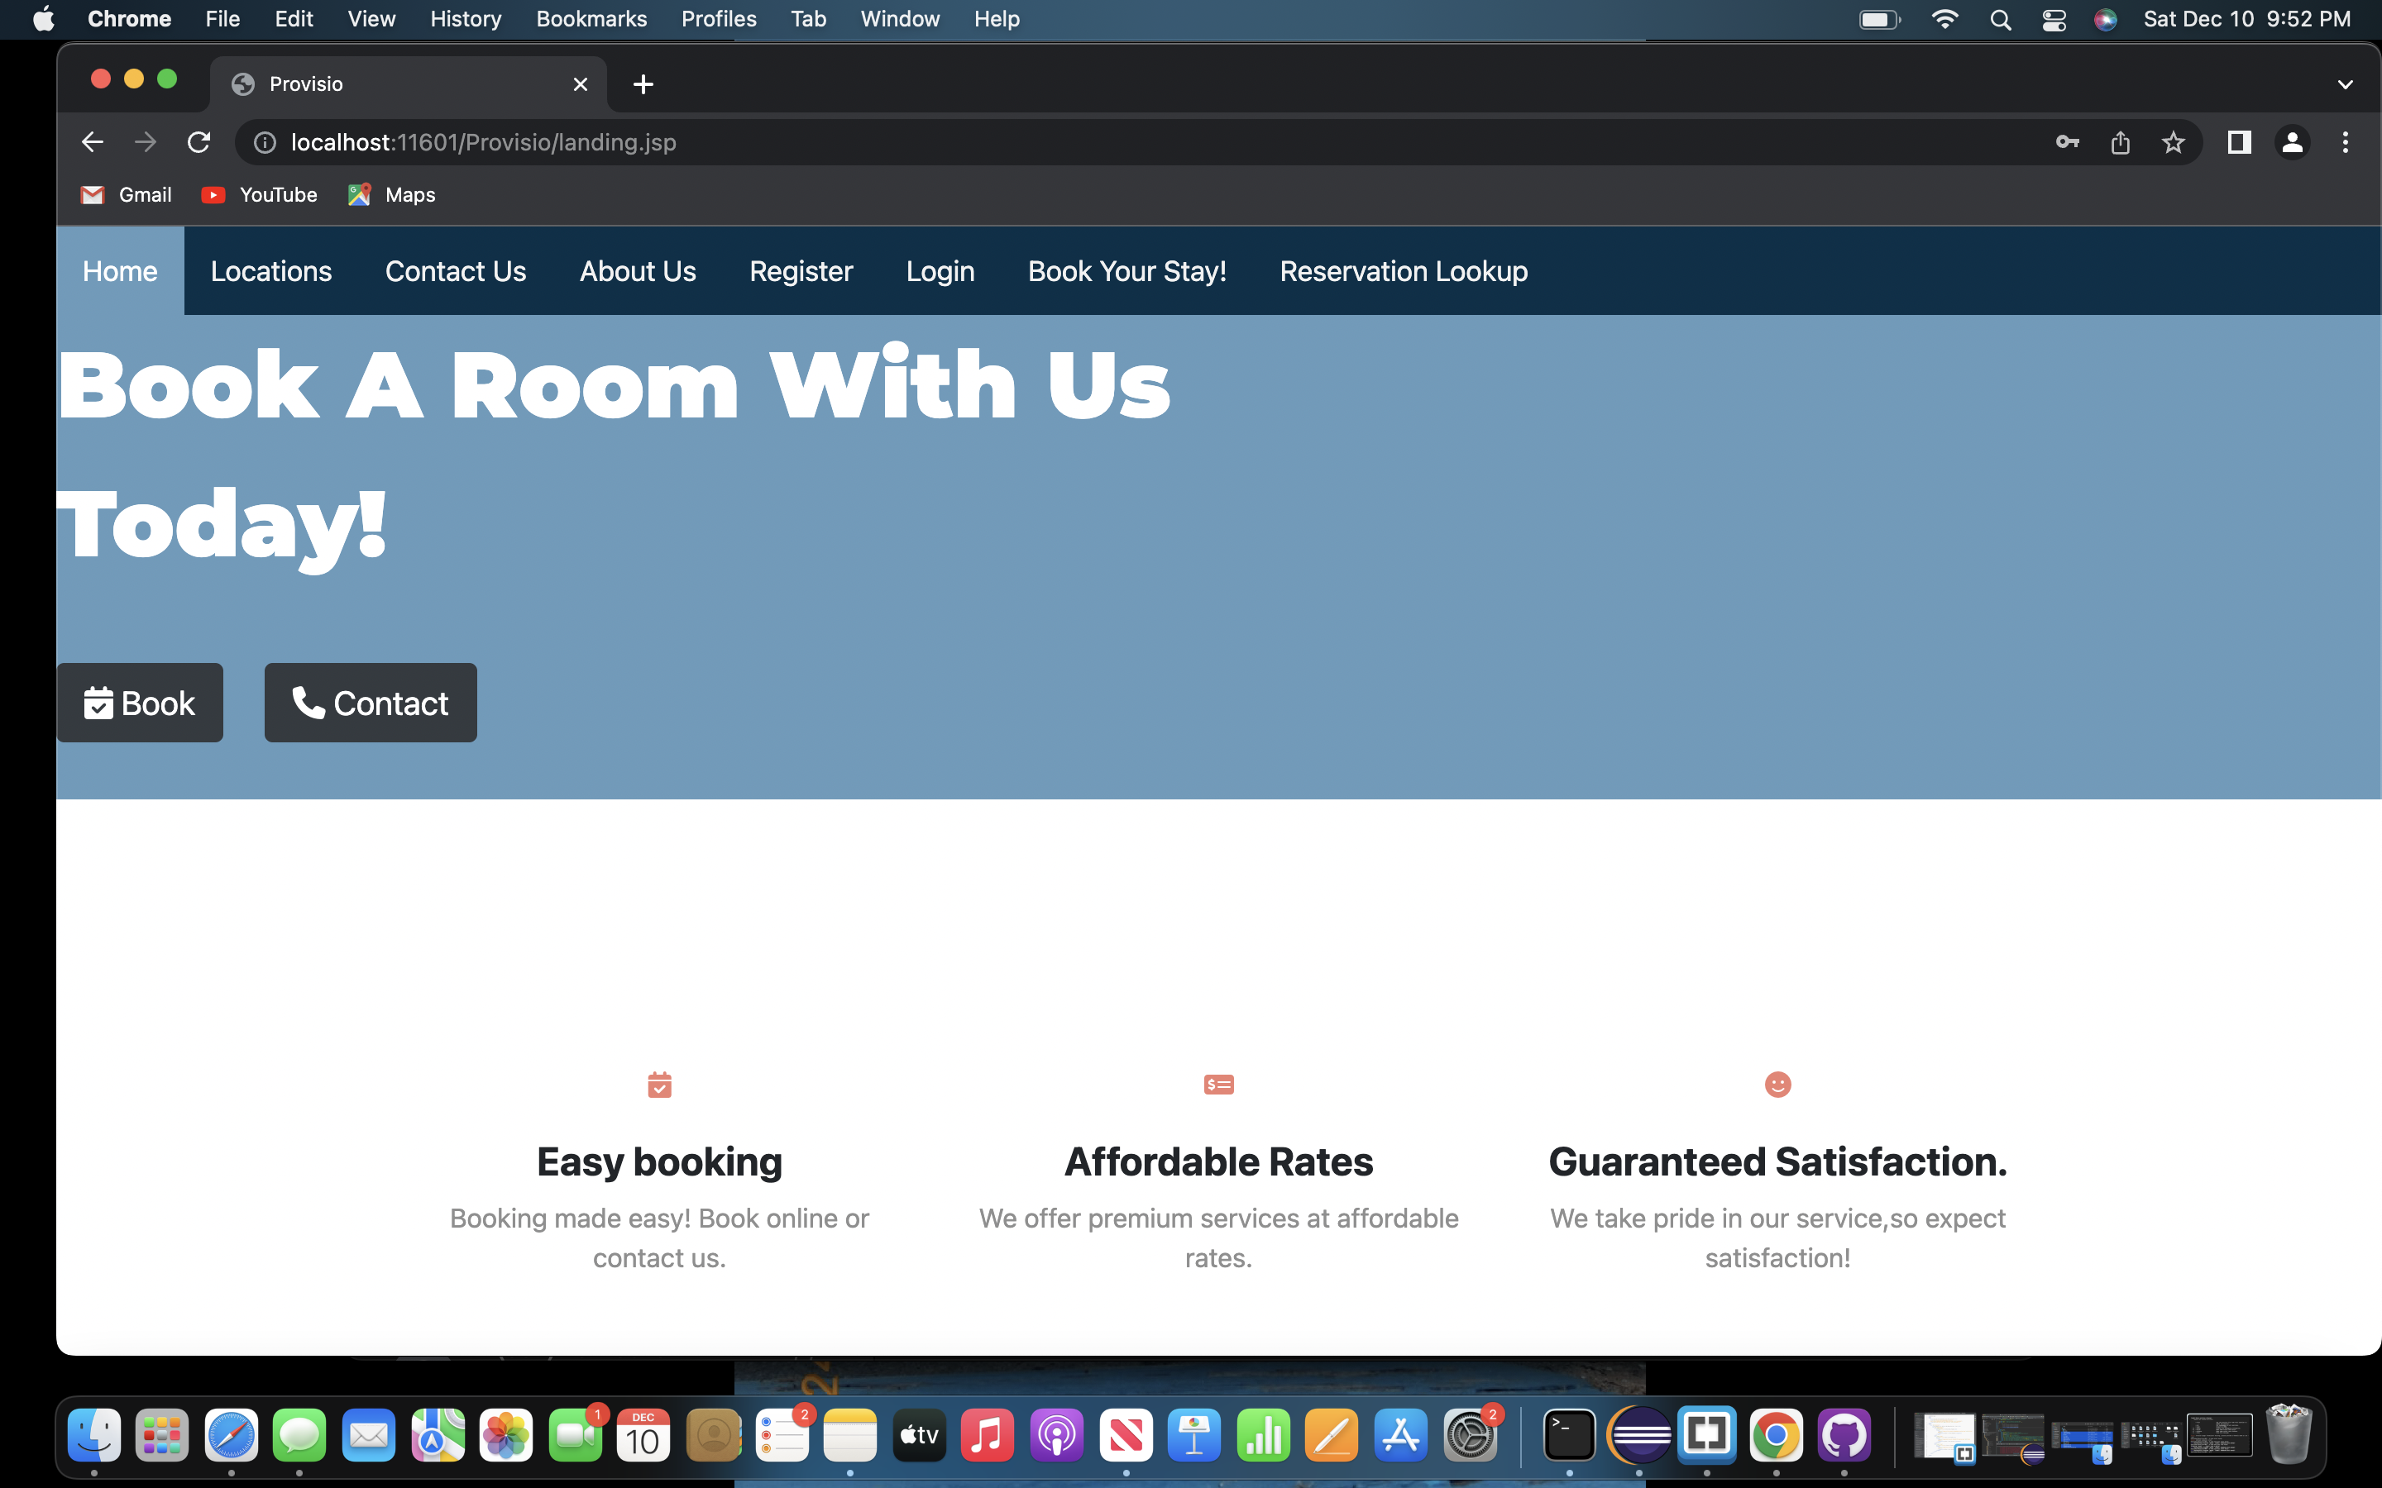
Tests – Login Page
Tested the user's ability to successfully login into their account
The test consisted of the following steps:
Navigate to the Login Page
Entered the required information in the Login Form
Selected Submit
The user was able to successfully login from the Login Form and be navigated back to the Home Page

Slide 20
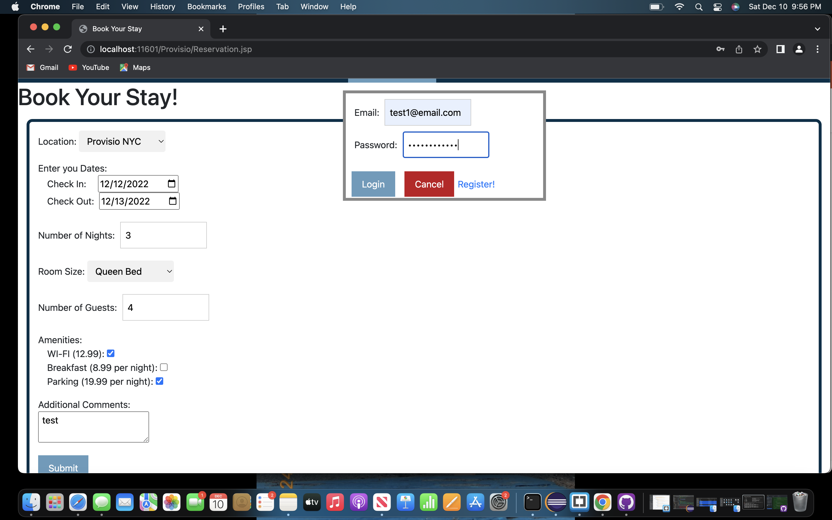
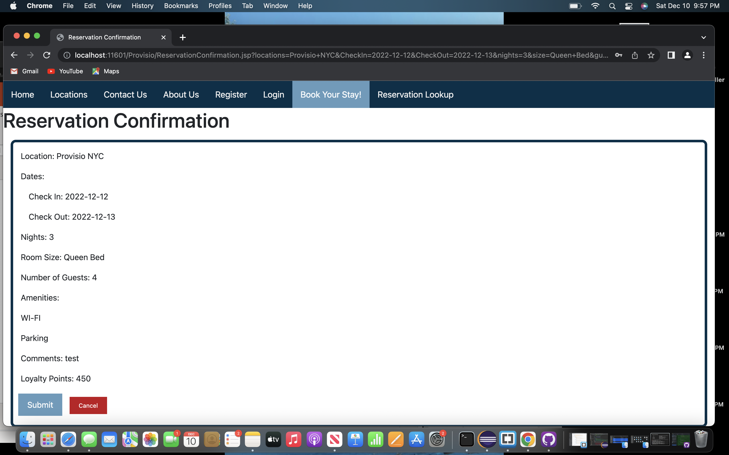
Tests – Reservation Page
Tested the user's ability to complete the Reservation Form and complete the Login Popup
The test consisted of the following steps:
Navigate to the Reservation Page
Fill Out the Reservation Form
Select the Submit Button
Fill out the Login Form in the Login Popup
Select the Submit button
The user was able to successfully submit a Reservation Form and the Login Popup

Slide 21
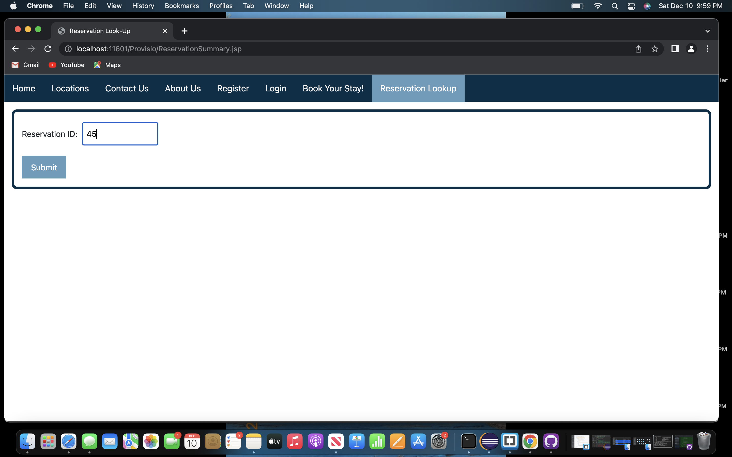
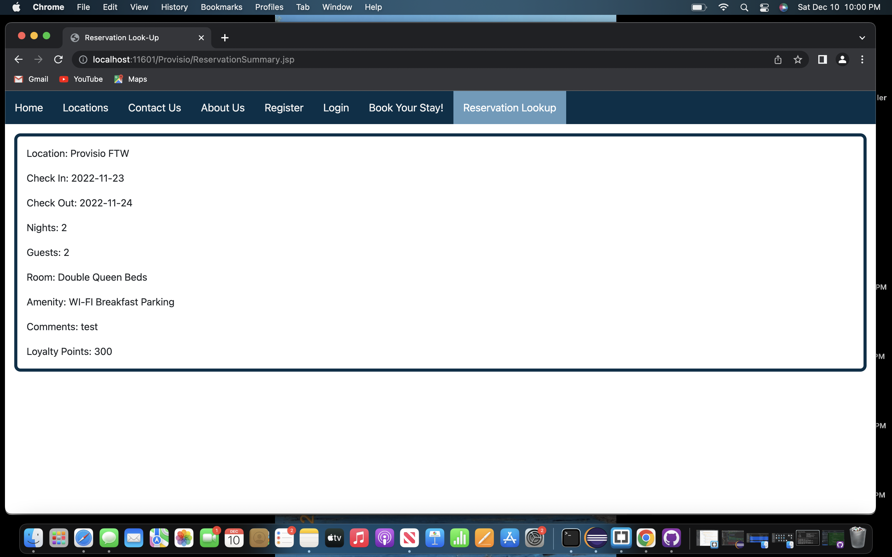
Tests – Reservation Lookup
Tested the user's ability to lookup a previous reservation in the Reservation Lookup Page
The test consisted of the following steps:
Navigated to the Reservation Lookup Page
Entered a Valid Reservation ID
Selected the Submit button
The user was able to successfully lookup a Reservation

Slide 22
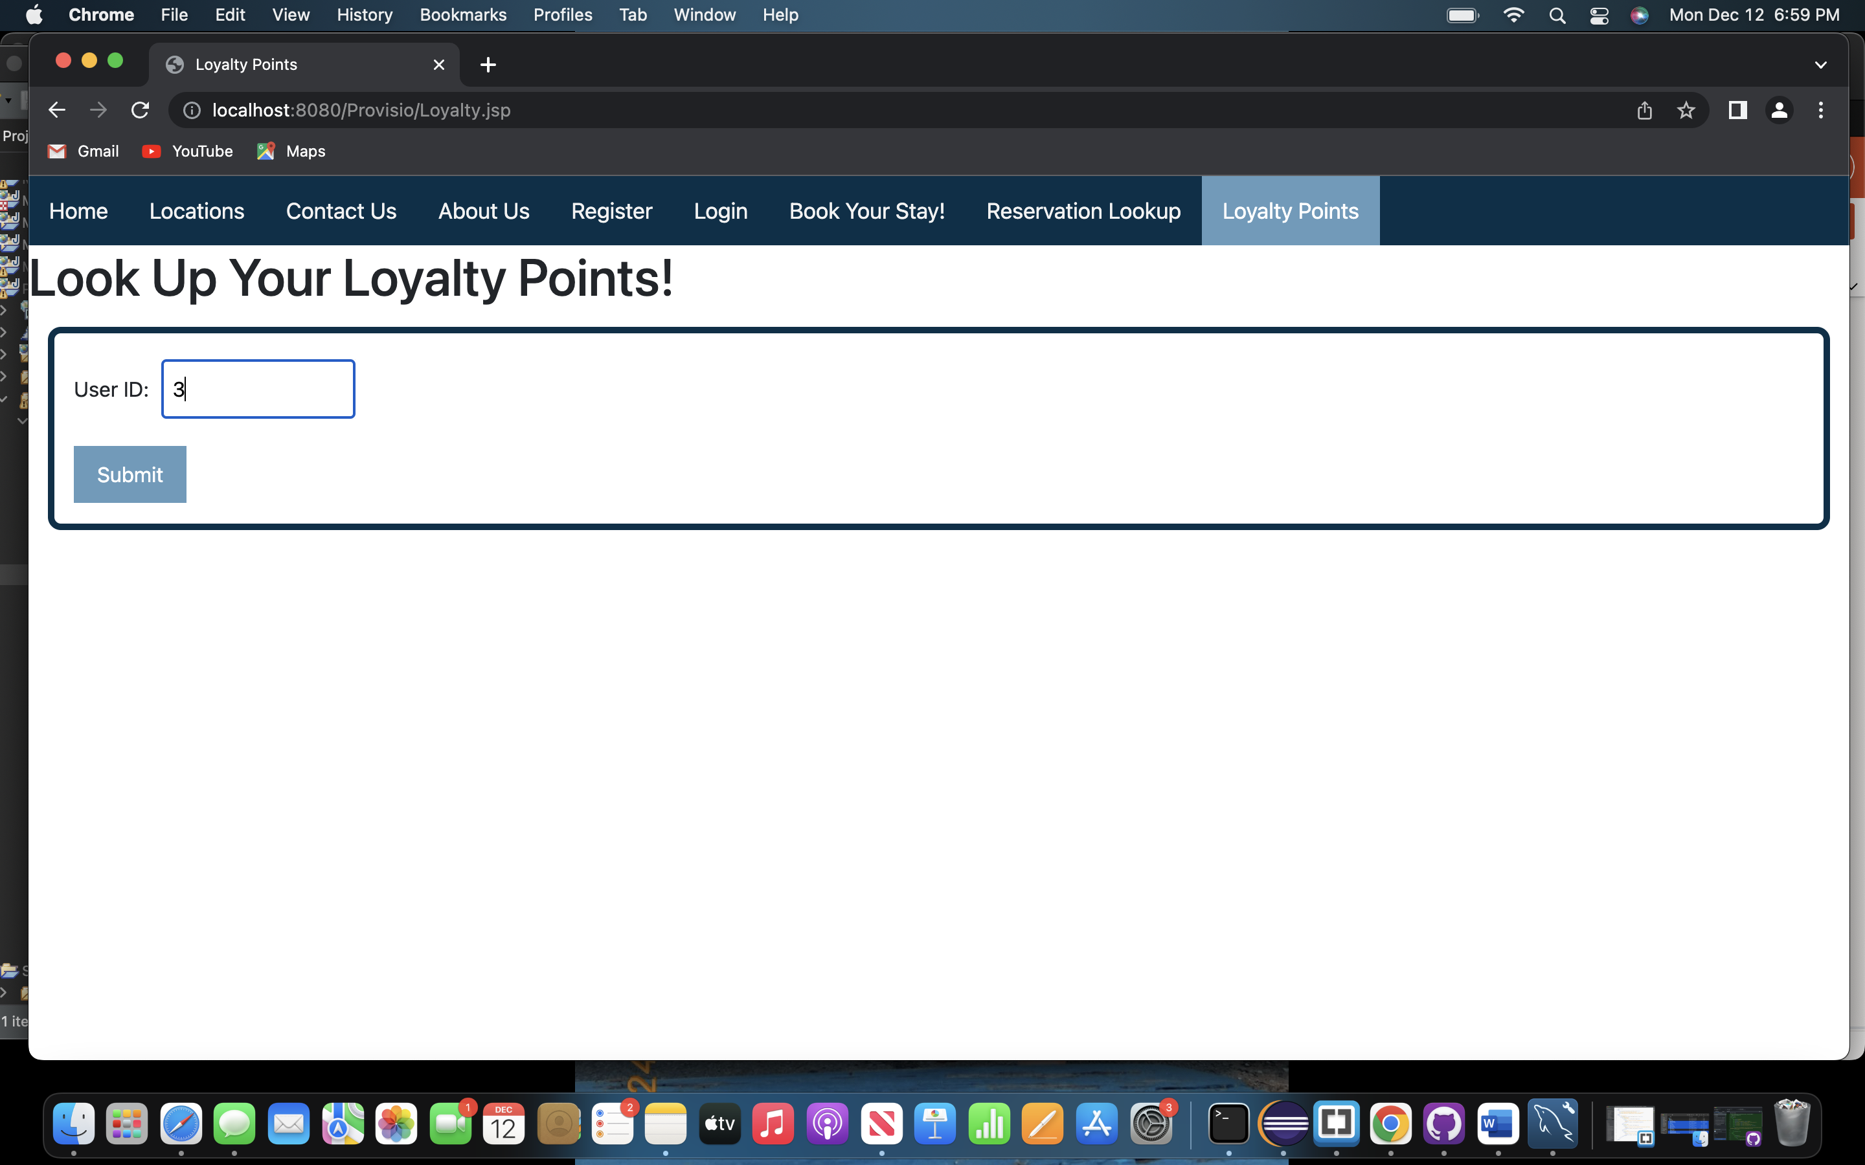
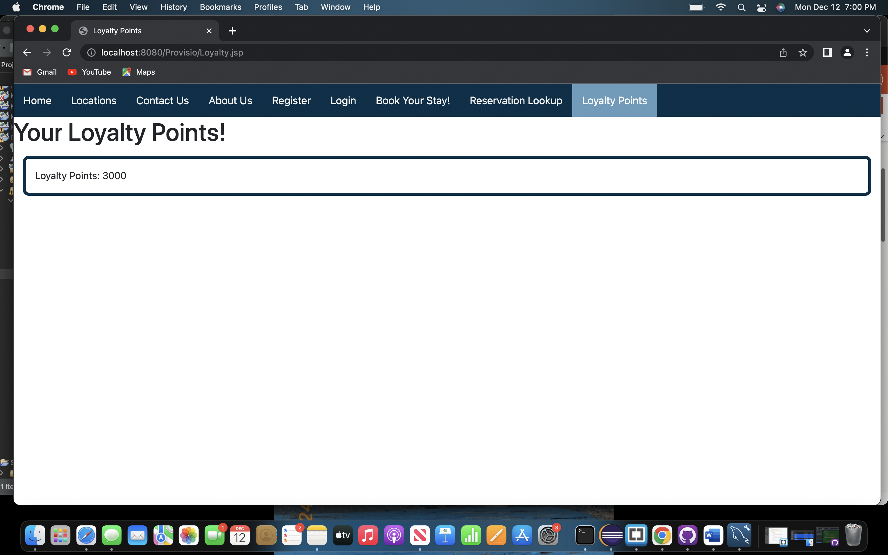
Tests – Loyalty Points
Tested the user's ability to look up a User's Loyalty Points
The test consisted of the following steps:
Navigated to the Loyalty Points Page
Entered a Valid User ID
Selected Submit
The user was able to successfully view the Loyalty Points for the User ID that was entered

Slide 23
Lessons Learned
A few things that we learned throughout this project:
We should have designed a color palette at the beginning of the project, this would've prevented us from having to update CSS code throughout the project
We learned how to create a schedule that worked with everyone's personal schedules, this helped us time manage items within the project
We learned how to use different tools to collaborate with one another throughout the project, such as GitHub or Blackboard Collaborate

